Slide 1

Smart House
Presented By:
Muhamad Burhan

Slide 2
Outline
Abstract
Introduction
What is smart house
Objectives of the study
Problem statement
Design
Result
conclusion
Future work

Slide 3
Abstract
Smart house is one of the major growing industries that can change the way people live. Some of these home automation systems target those seeking luxury sophisticated home automation plat form, Typical wireless home automation system allows one to control house hold appliances from a centralized control unit which is wireless. These appliances usually have to be specially designed to be compatible with each other and with the control unit for most community available home automation systems.

Slide 4
Introduction
Technologies that help seniors to live a quality life and to be more self-sufficient in everyday life are being developed. One of the fields of this development and innovation of modern technologies is smart house to ensure independent living for senior citizens or disabled people in household environment with the option of assistance care. Introduction The demography of the world population shows a trend that the elderly population worldwide is increasing rapidly as a result of the increase of the average live expectancy of people. Caring for and supporting this growing population is a concern for governments and nations around the globe.

Slide 5
What is smart house
Smart house is one of the major growing industries that can change the way people live. Some of these home automation systems target those seeking luxury and sophisticated home automation platforms; others target those with special needs like the elderly and the disabled. The aim of the reported Wireless Home Automation System (WHAS) is to provide those with special needs with a system that can respond to voice commands and control the on/off status of electrical devices, such as lamps, fans, television etc. in the home. The system should be reasonably cheap, easy to configure, and easy to run.

Slide 6
Objectives of smart house
Although smart house would make living alone easier, some if not most of elderly finish people are a bit stubborn and refuse to use modern devices or to be under constant surveillance.
The most popular smart house solutions are burglar alarm, fire, lighting and heating system, with those solutions living could be more cam for table, easier and safer, those smart homes could be controlled by smart phones or tablets with their internet connection for away from home.
making smart devices arrange all daily schedule and appointment with reminding the user daily tasks by navigation every morning.
Commanding iPad or monitors to read books or magazines and daily news.

Slide 7
Problem statement
Our Project is Facilities to control your smart devices in your home, And it make life easier and more comfortable. If any one use our system to control there house, that will make them life more safely and have less or non Danger.
All the sensor and the devises are connected with the router or your Wi-Fi, which means that you can control every smart devise in your house by internet, but the only negative thing you going to face it is problem with your internet or Wi-Fi, you can’t run your system you have to do it by your own.

Slide 8
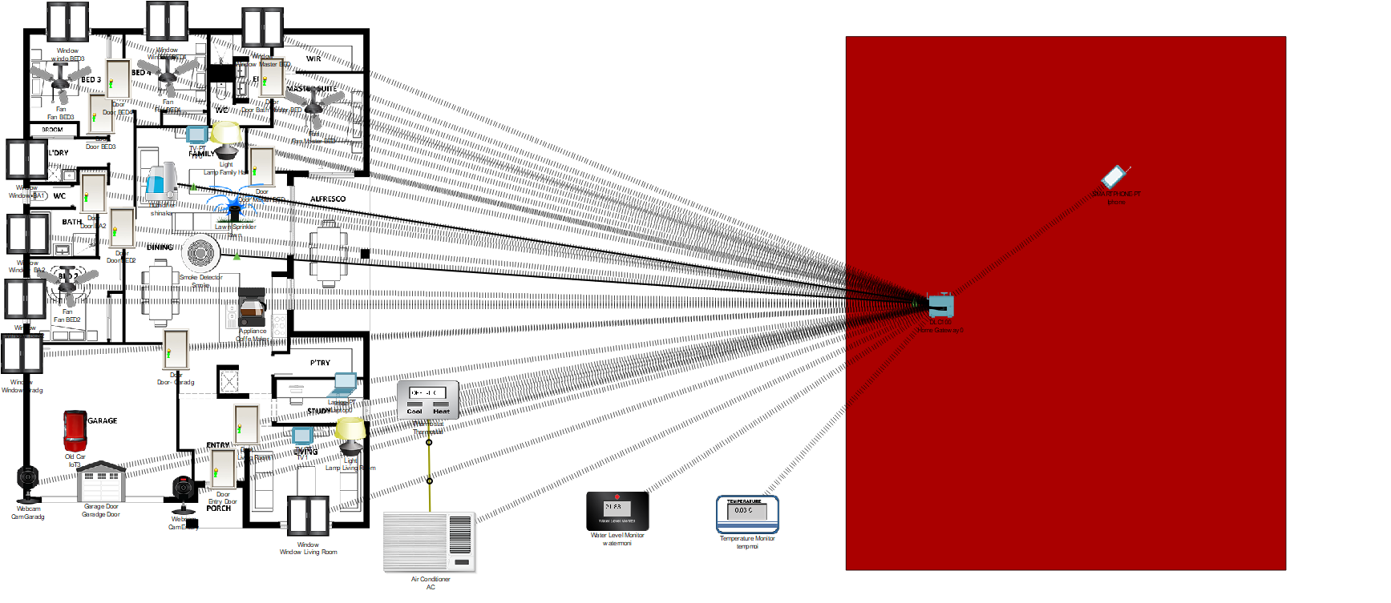
Prototype

Slide 9
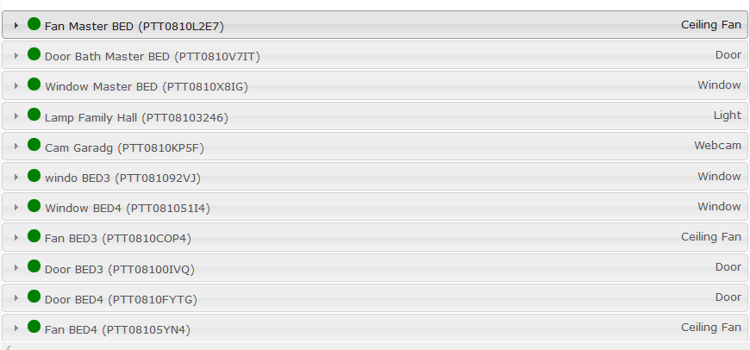
Result

Slide 10
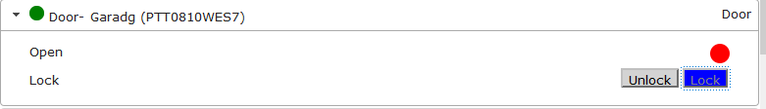
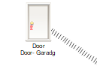
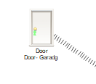
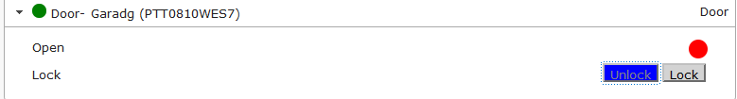
Doors

Slide 11

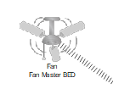
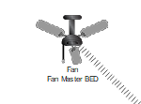

Fans

Slide 12
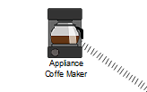
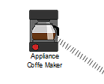
Coffee machine

Slide 13

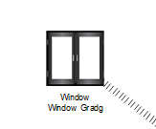
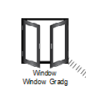
window

Slide 14
Conclusion
A low cost, flexible and source system is proposed.
Home automation is undeniably a resource which can make a home environment automated. People can control their electrical devices via by these home automation devices and set up controlling actions through their mobile.
Identified the problems of exiting home automation system.
Smart house systems are directed towards primary residences.

Slide 15
Future work
Developing home automation service for monitoring home automation devices like motion sensors and energy meter. In future this product may have high potential for marketing. Furthermore voice system is going to get high demand by people through developing technology moment by moment to easy using easy control by the controller. Also voice command may be so easier to use instead of looking for the place of the remote control or looking for a method for providing energy to the control remote.

Slide 16
Thank you ☺ Any questions ?

